Slide 1
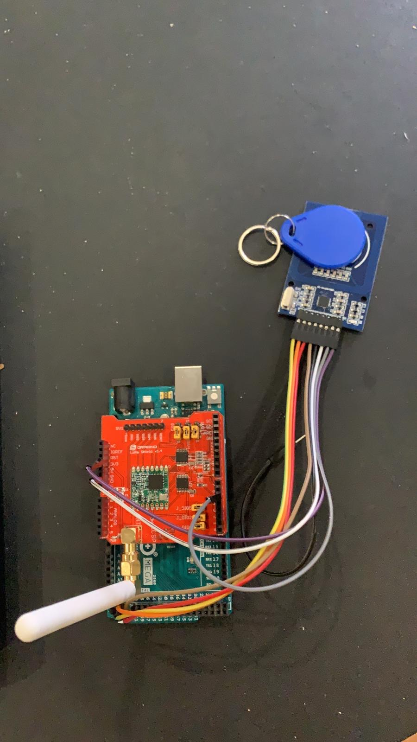
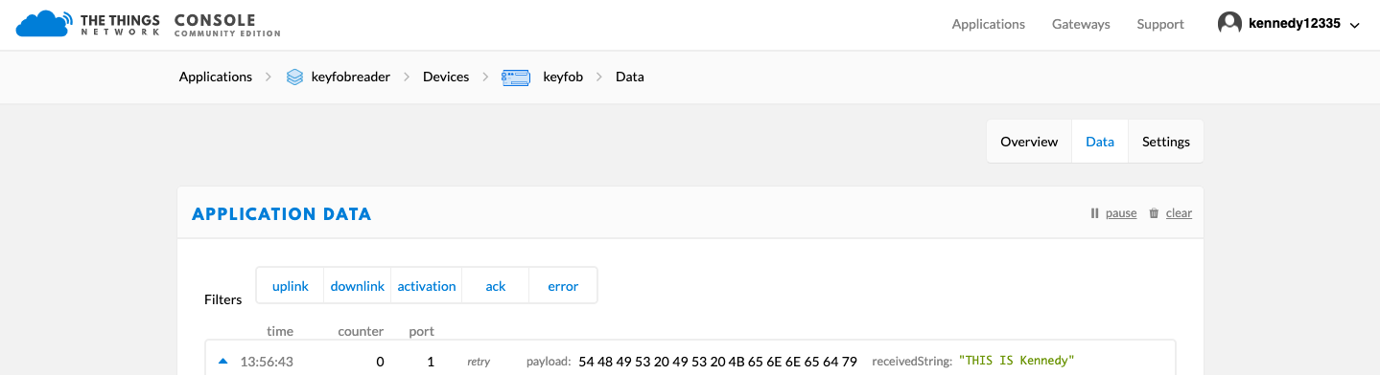
RFID TAG READER AS A LoRaWAN APPLICATION BY: KENNEDY DIKE & OBIDIEGWU ONYEKACHI
In collaboration with Tinsley bridge
DEVICE OVERVIEW
This device reads an RFID tag and sends this information over LoRaWAN to a user.
COMPONENTS
ARDUINO MEGA
RC522 tag reader
Dragino LoRa shield
RFID TAGS
APPLICATIONS
Attendance monitoring.
Alarm System (Test case).
Machine security.
General warehouse accountability.

